Slide 1
User input/ Error Handling
By Nasirdin

Slide 2
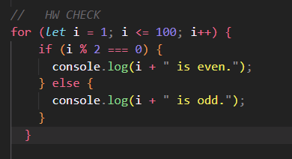
HW

Slide 3
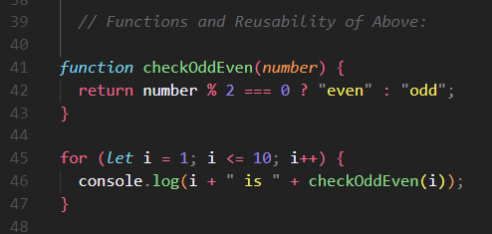
Functions and Reusability

Slide 4
User Input and Validation
Using prompt() to gather user input.
Validating input to ensure it’s a number.
Handling invalid input gracefully.
let userInput = prompt("Enter a number:");
isNaN - value is not a number
parseInt() - Convert String to INT

Slide 5
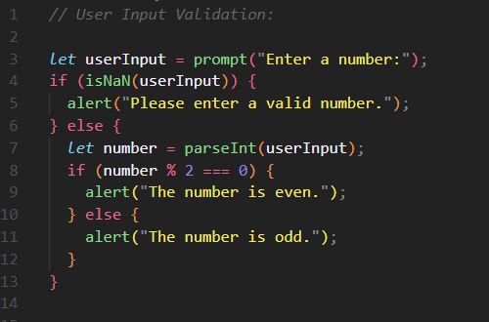
User Input

Slide 6
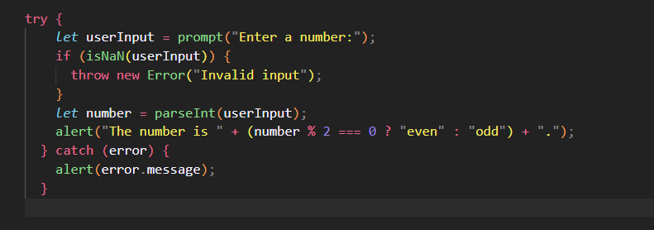
Basic Error Handling (try-catch)

Slide 7
Practical Task: Mini Calculator
Concepts:
User input for two numbers.
Performing arithmetic operations.
Checking if results are odd or even.
Validating input.

